Slide 1
N Line Future Station Area Planning
City Council Planning Session 1/20/26

Slide 2
Purpose
Agenda
Background
  Strategic Plan implementation action
  Context for the N Line & Thornton
  Comprehensive Plan and Future Land Use Map
  Station Area Master Plan planning process and case studies
Planning Opportunities for STAMPs
  Active developer interest in station areas
  Scope of STAMP: Area planning, existing conditions review, market analysis, infrastructure/service assessment, intergovernmental/agency coordination, scenario development and selection
  Community engagement throughout
An overview of proposed Station Area Master Plans for the future N Line Stations
Request Council direction to proceed with developing an RFP for consultant services to support development of two Station Area Master Plans (STAMPs) for future station areas
Budget capacity identified in 2026 Budget

Slide 3
Strategic Plan Implementation Action
Vibrant and Purposeful Development
Goal: Plan for the future buildout of Thornton to include goals for annexation and growth, targeted areas/industries for the City and the fiscal impacts of land uses.
Action: Review the City’s comprehensive plan and Station Area Master Plans (STAMP) to include modernizing the vision, opportunities for increased density and a strong community engagement plan.
Notes:
Vibrant and Purposeful Development
Actively pursue mixed-use and walkable development and redevelopment that include diverse housing choices. Attract commercial development with appealing amenities and economic opportunities that offer destinations for the community and visitors. Maintain inviting public spaces and facilities to inspire community pride and enjoyment.
TOUCH ON DRCOG grant for existing STAMPs

Slide 4
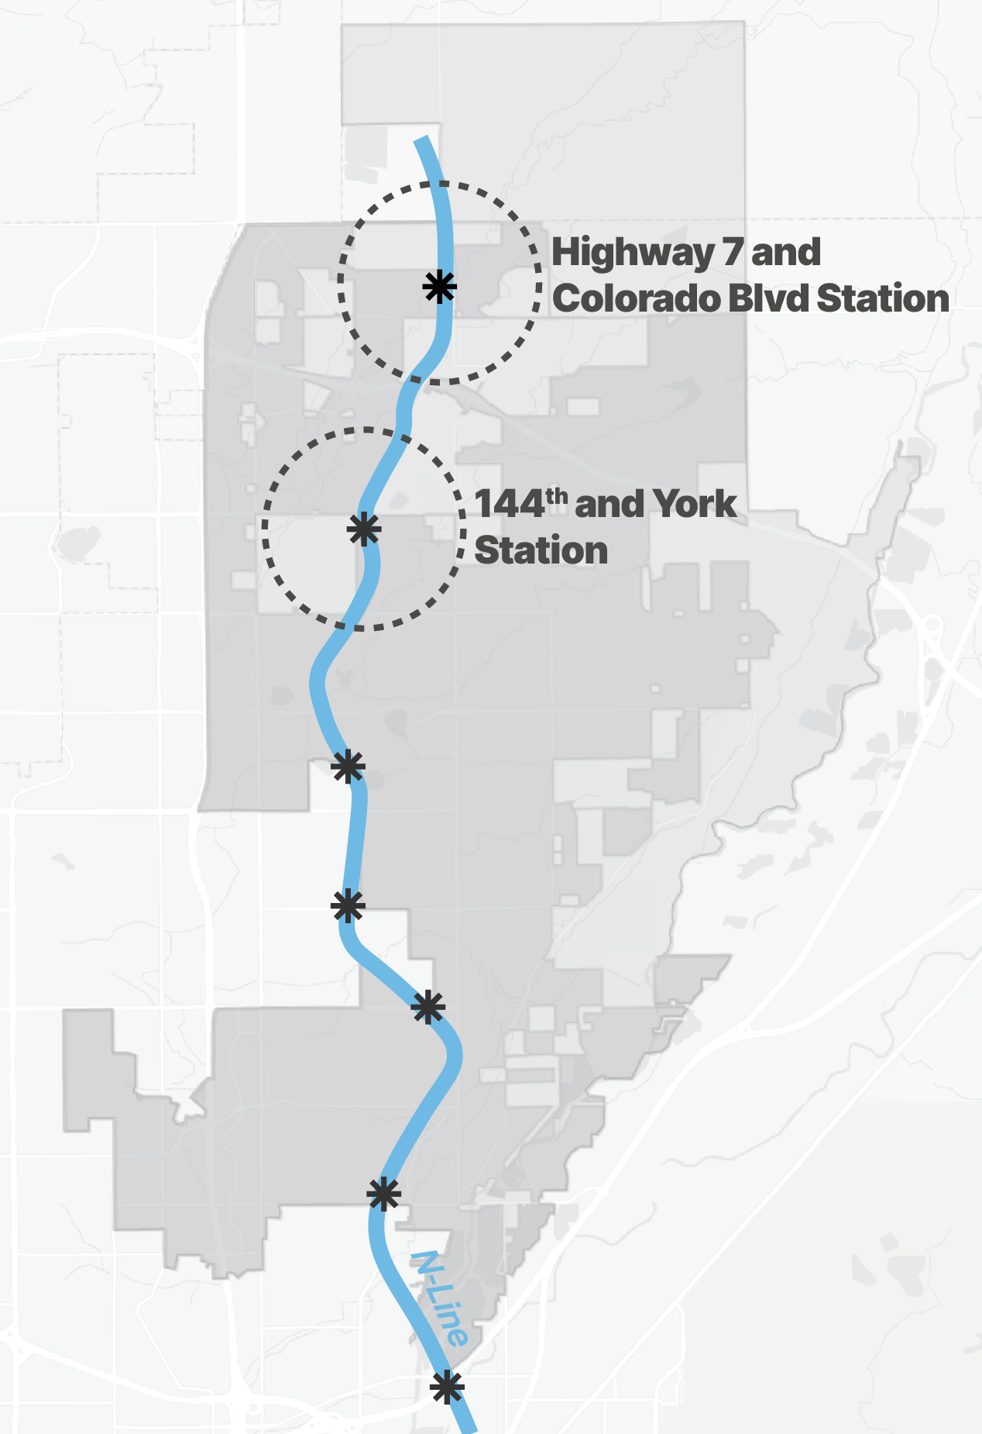
Future N Line Station Locations
Proposed planning area defined as 1-mile buffer from proposed station locations

Slide 5
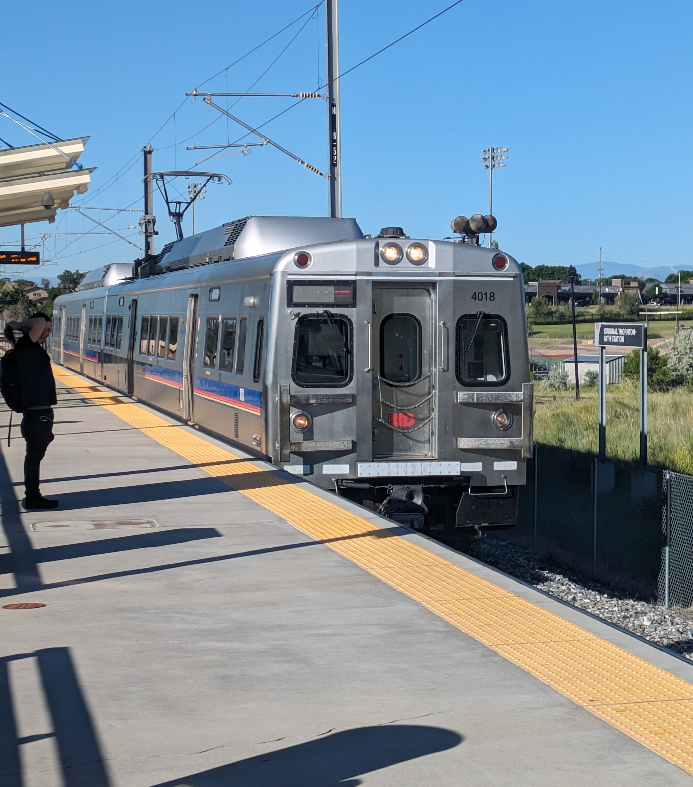
Future N Line Stations in Context
Thornton Comprehensive Plan
Future Land Use Map designation and Placemaking Guidelines provides high-level guidance on future stations
City Council Strategic Plan
Focus Area: Vibrant and Purposeful Development
Colorado Legislative Work
SB 24-230: Requires prioritization of N line completion by 2035
SB 25-161: Reporting on FasTracks progress with financial information – Finishing FasTracks report
Development Interest
Pre-applications and active development near future stations
Notes:
Development Interest/Neighboring Cities – Northglenn Settlement Agreement, need to work with neighboring cities/jurisdictions
Goal CPP 1: Work with partners to develop an effective and equitable multi-modal transportation system that serves all residents, businesses, and visitors.
City Council Strategic Plan: Several goals could support the development of STAMPs and station areas more broadly. Specifically, there is one direct connection to STAMP work in the Goal: Goal: Plan for the future buildout of Thornton to include goals for annexation and growth, targeted areas/industries for the City and the fiscal impacts of land uses.
- Review the City’s comprehensive plan and Station Area Master Plans (STAMP) to include modernizing the vision, opportunities for increased density and a strong community engagement plan.

Slide 6
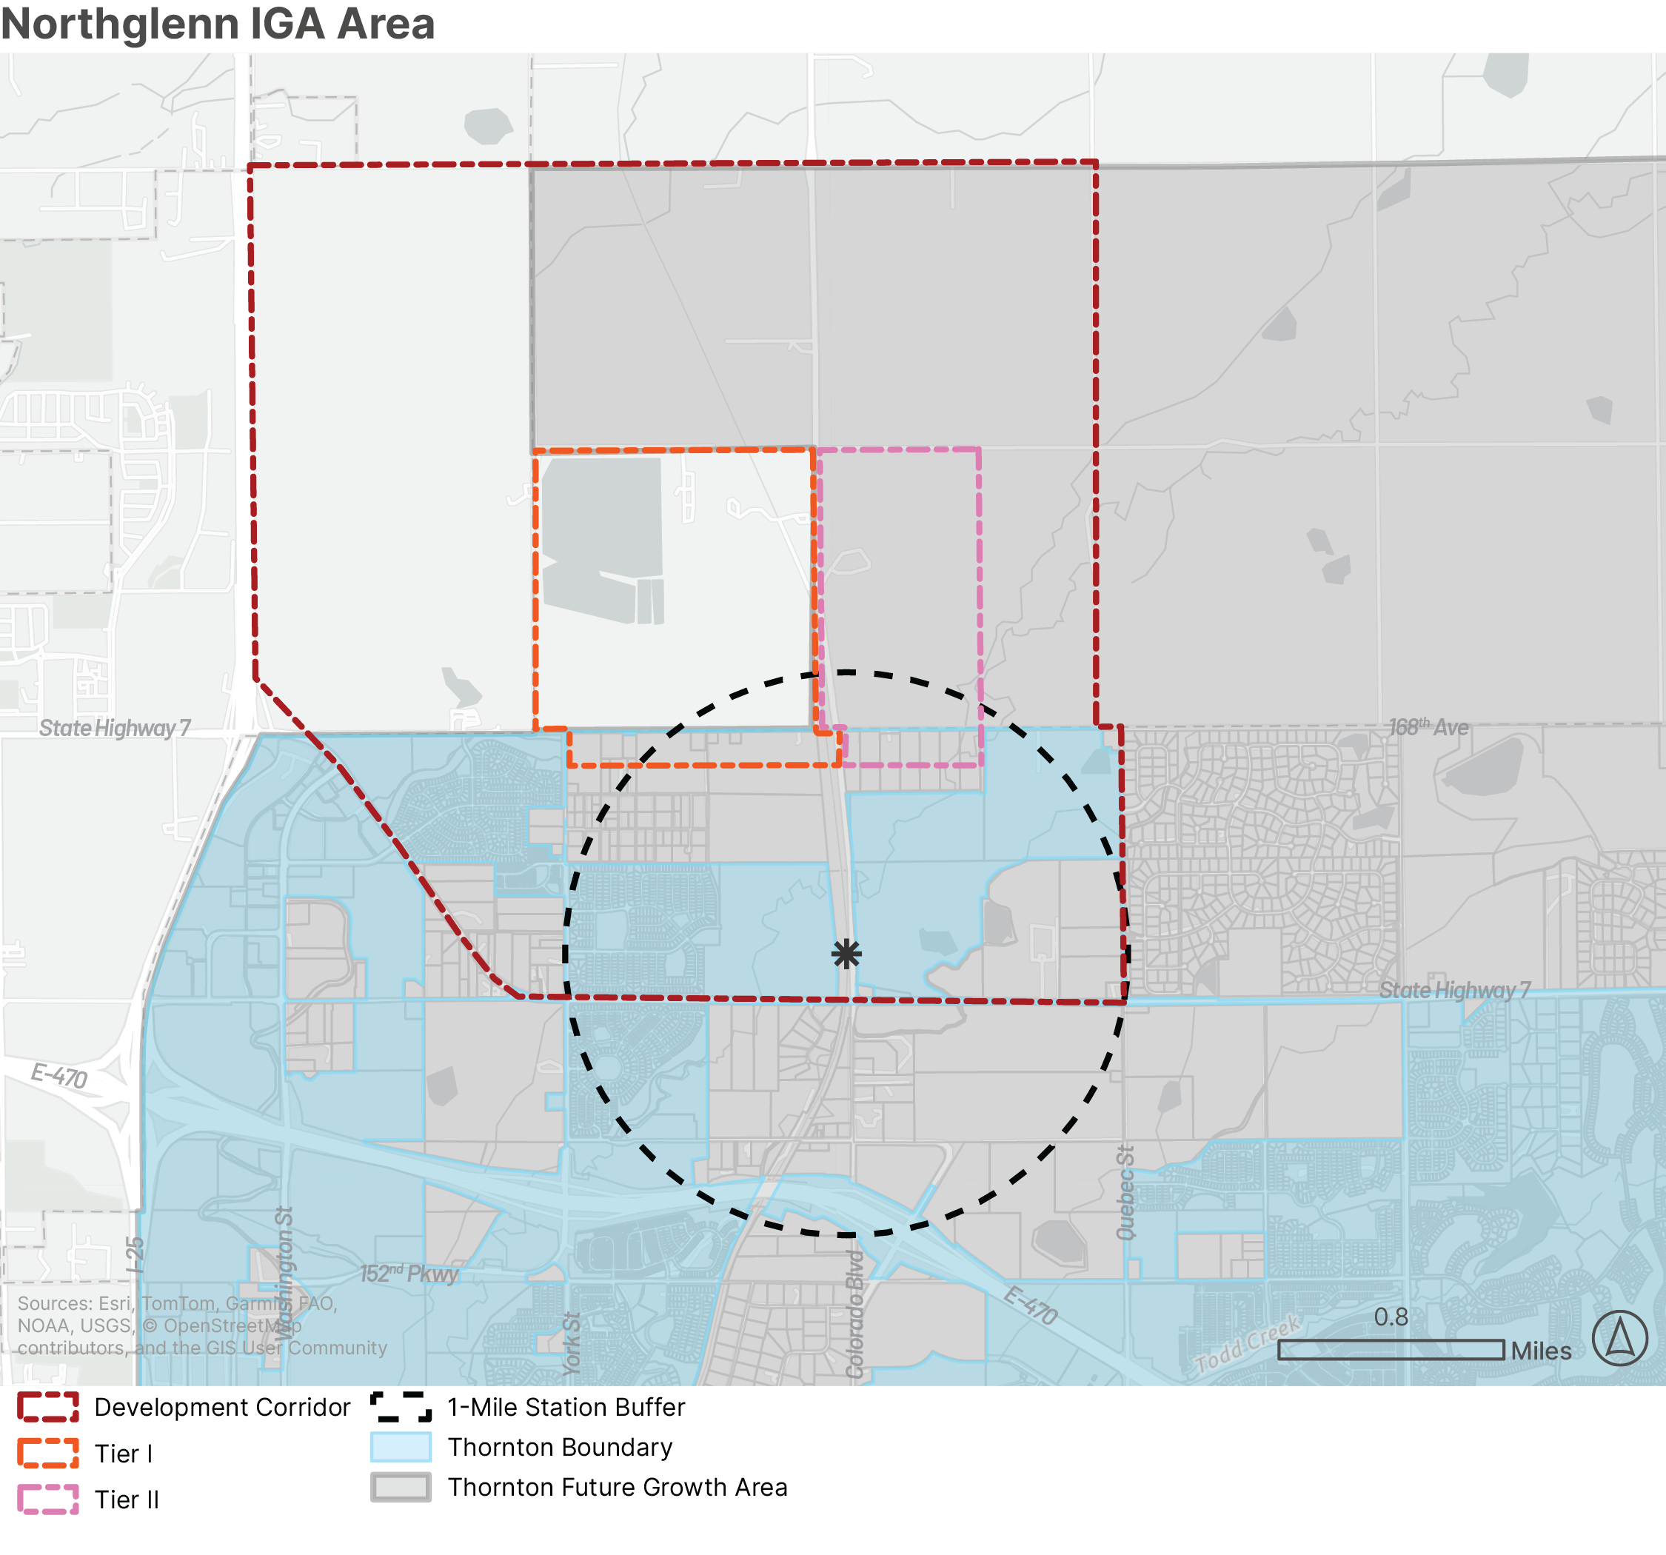
Northglenn Settlement Agreement Land Use Restrictions
1992 Northglenn Settlement Agreement restricts land uses within the Highway 7 at Colorado Station Area
Renegotiation of these restrictions is necessary to make development fiscally viable in the Highway 7 at Colorado station area.
Notes:
City conducted earlier 2019 analysis with consultant for the Comp Plan update (2020 Comp Plan) which was based on this Settlement Agreement. Concluded expansion into Weld wouldn’t be fiscally feasible with the restrictions. Need to renegotiate with Northglenn to remove restrictions to make this feasible.
Settlement Agreement Development Corridor covers both Adams County and Weld County areas, so it is impacting development even within Thornton’s growth area in Adams County. This is particularly difficult because there will be a terminal N Line train station in this area near Colorado Blvd and Hwy 7.

Slide 7
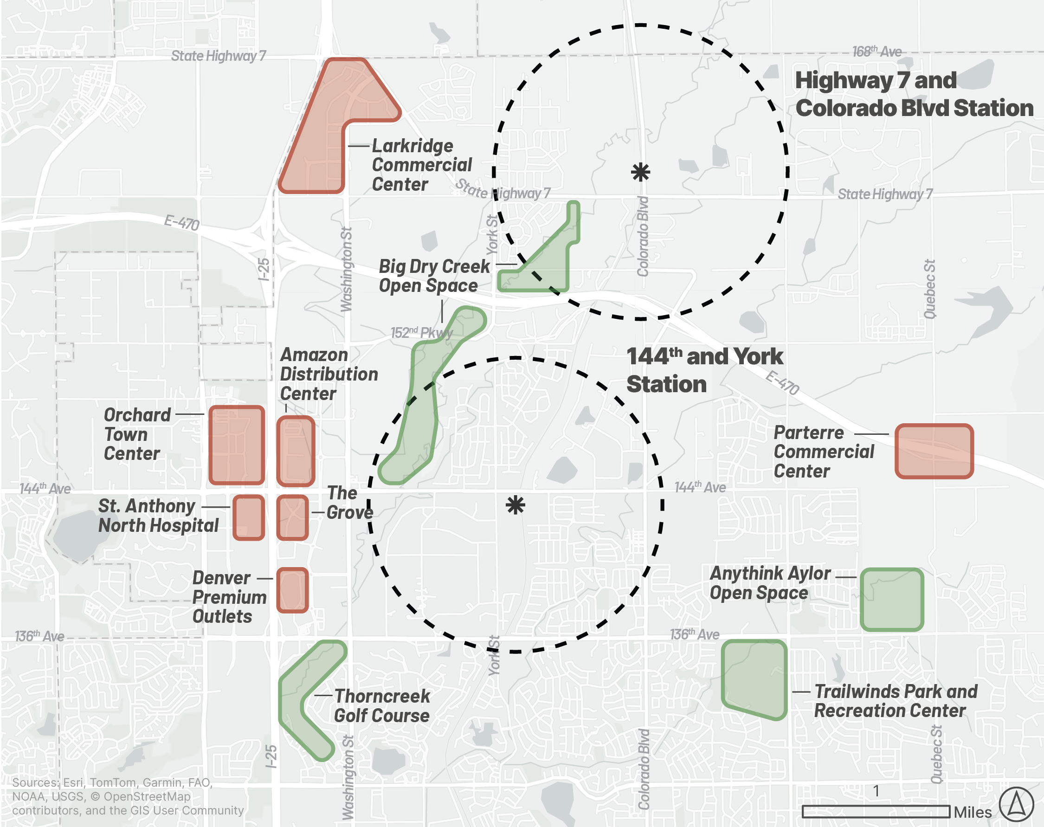
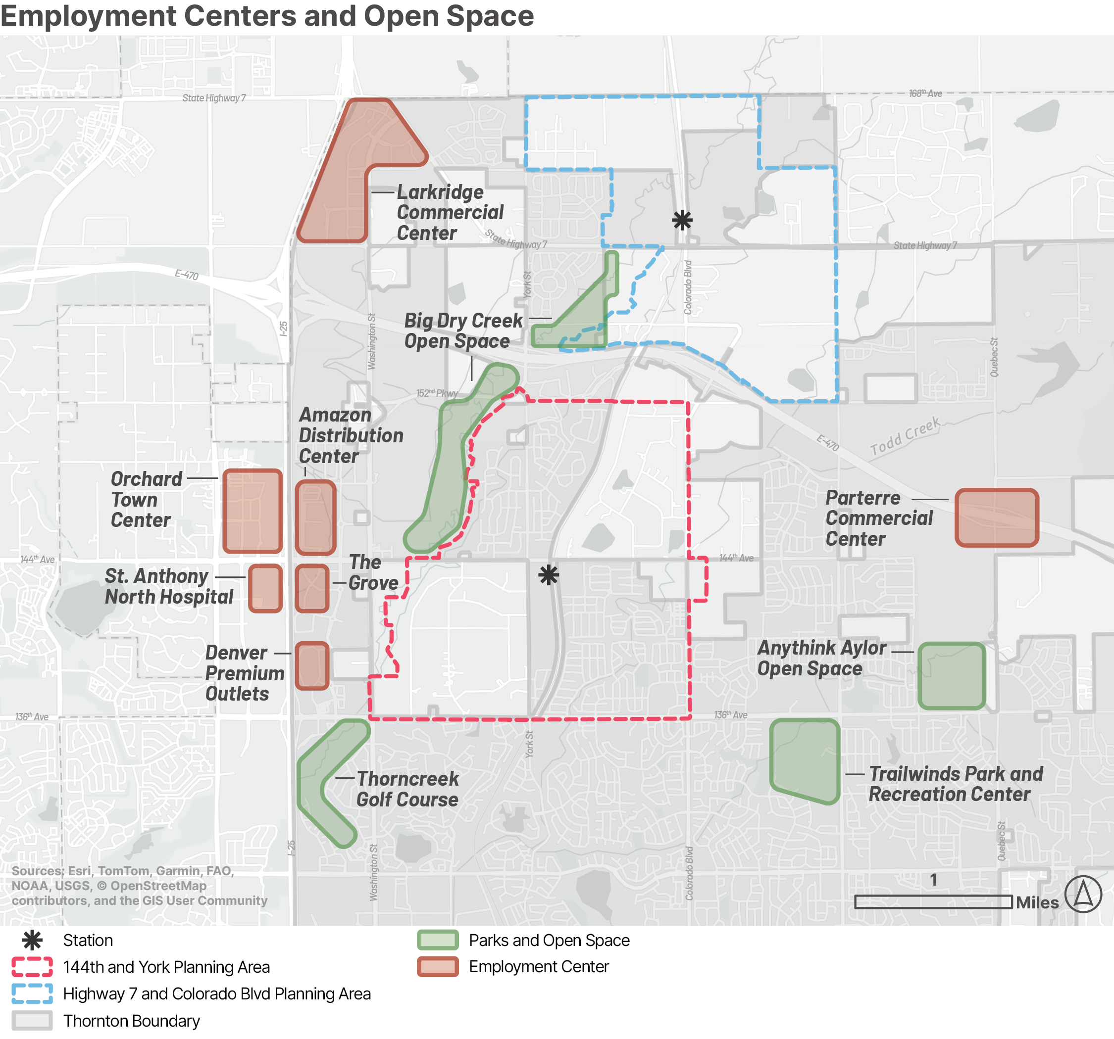
Future N Line Regional Employment Centers and Open Spaces

Slide 8
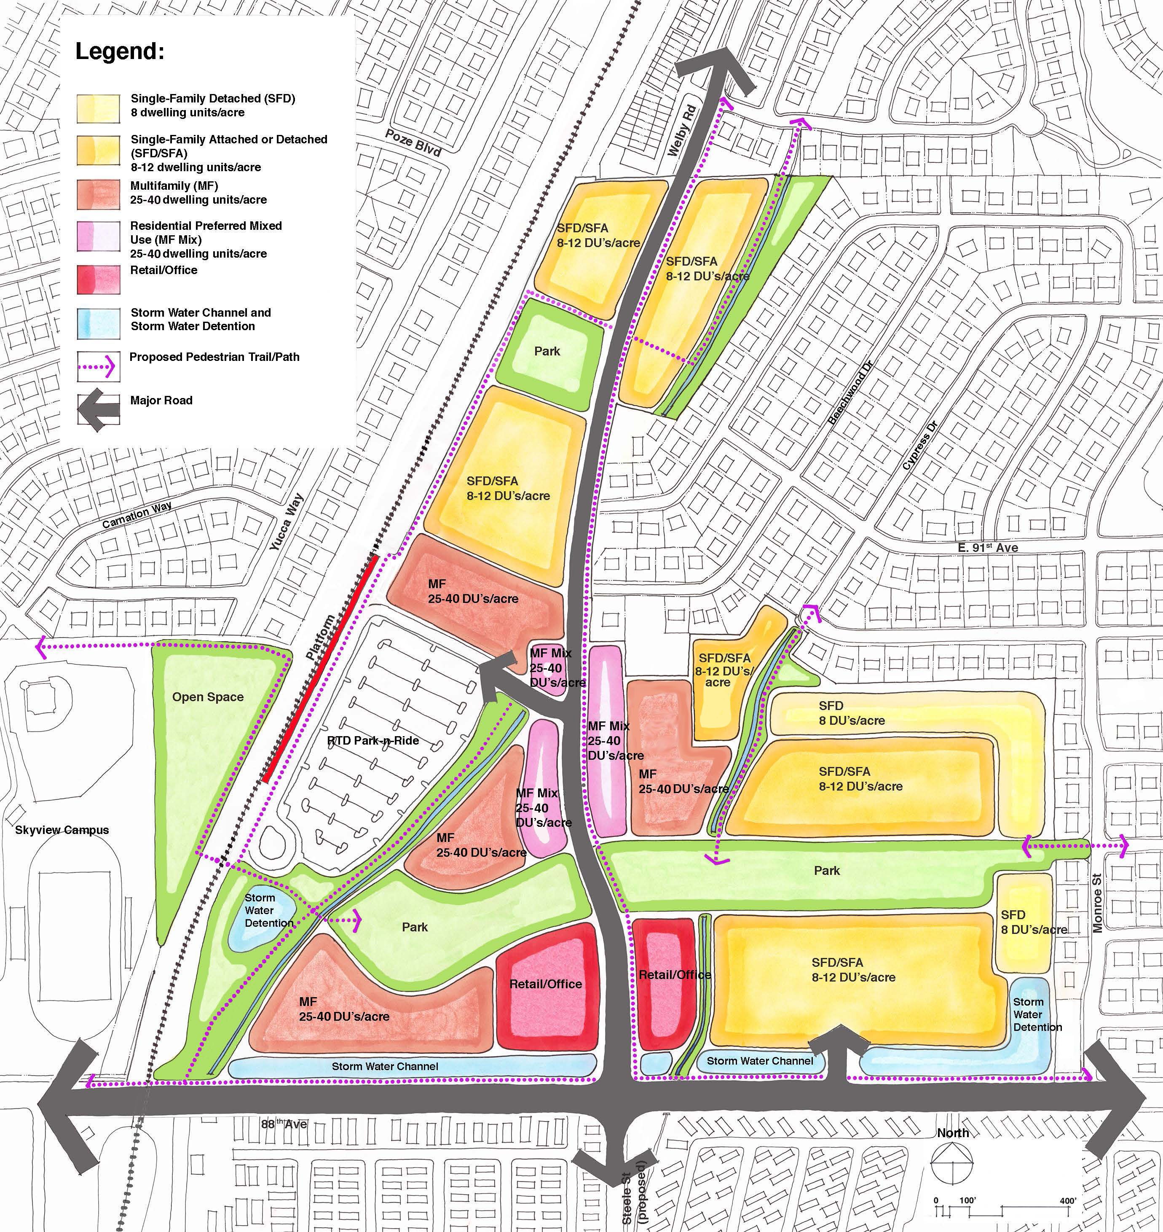
Plan Making, Comprehensive Plan, & STAMPs
The image to the right displays an example of the level of detail included in a STAMP land use alternative

Slide 9
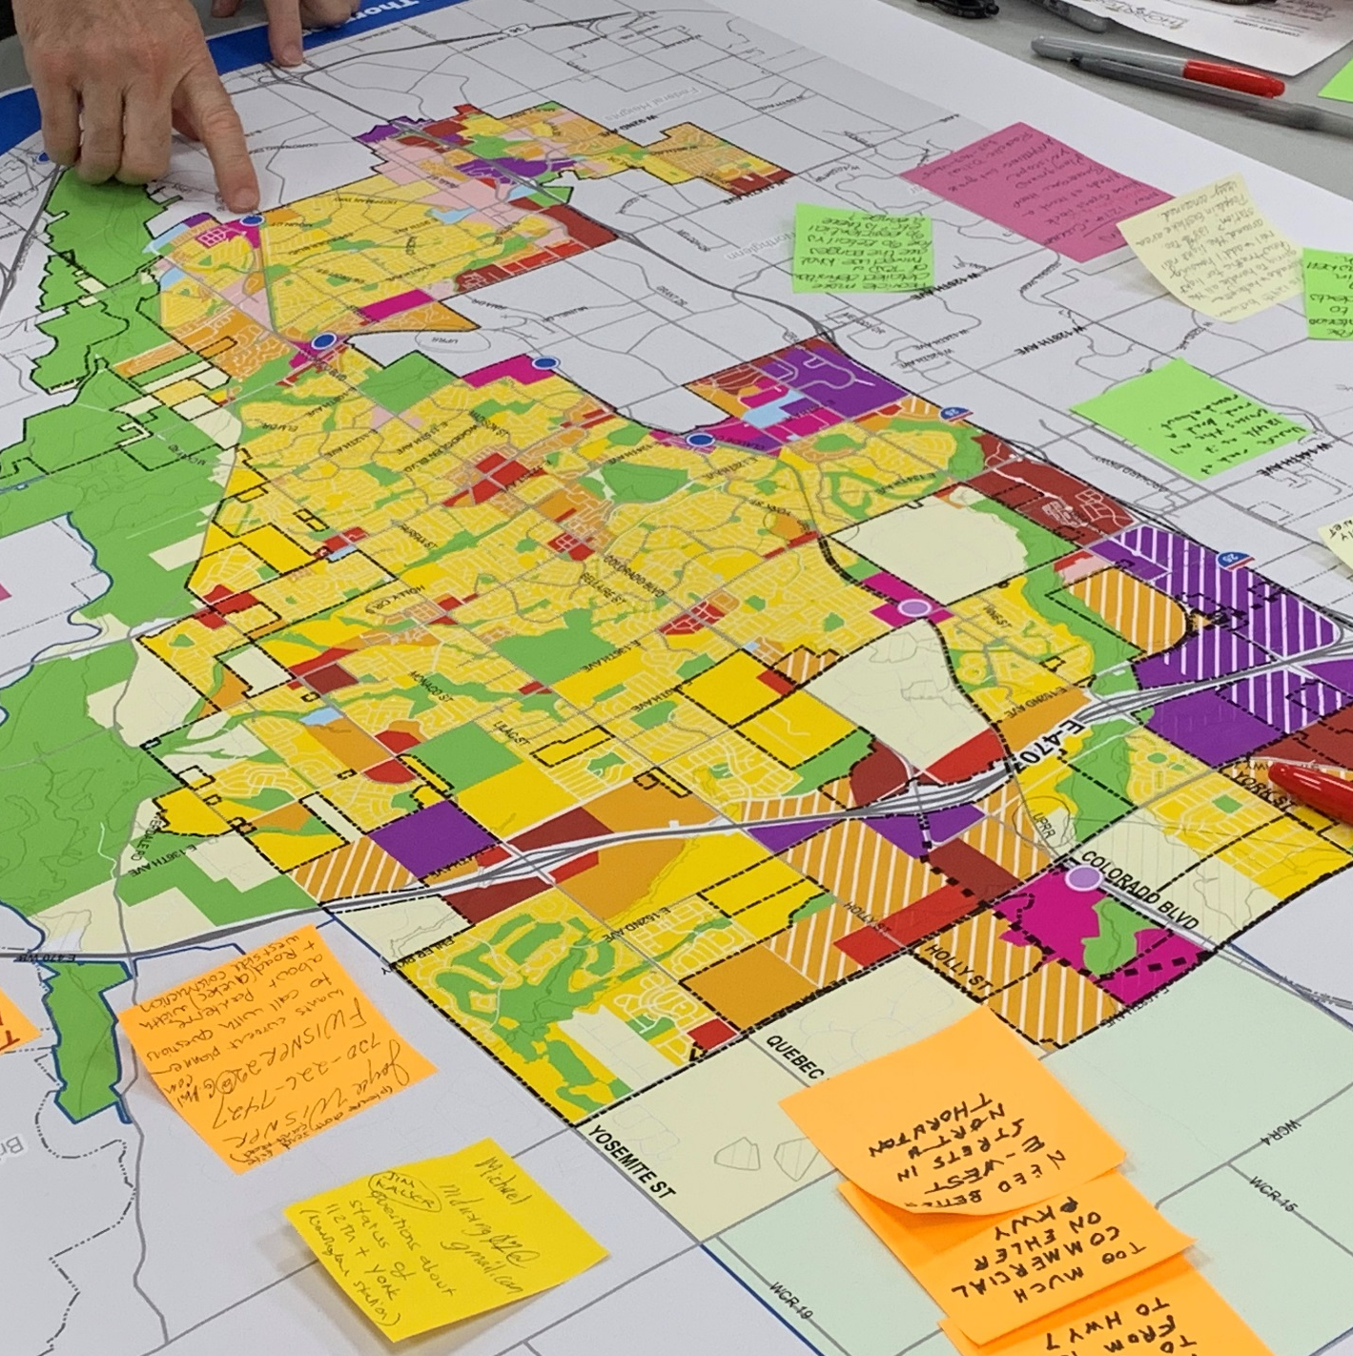
What Guides the City’s Long-Range Growth Decisions?
Thornton Comprehensive Plan
Blueprint for future development
Provides guidance for all other planning efforts in the city
Guides Council decisions on rezoning, annexation, infrastructure and service provision
Is comprised of a multitude of supporting documents more detailed and specific than the Comprehensive Plan
Future Land Use Map (FLUM)
Map within the Comprehensive Plan that shows the intended long-term land use pattern
Helps ensure future development aligns with City priorities for fiscal sustainability, infrastructure capacity, and urban design
Provides clarity for property owners, developers, and regional partners about the City’s long-term intentions
Notes:
Current Plan adopted in 2020, based on extensive community visioning
Major update every 10 year (should have 5 year mid-cycle updates) and amended as needed per developer proposals
Major updates reflect changing conditions, growth pressures, and community values.
FLUM does not show current zoning
Identifies where residential, employment, mixed-use, commercial, parks, and future growth areas are expected to develop.
Planning and analysis now ensures development happens in an orderly, fiscally responsible, and City-directed manner—rather than through reactive annexations or incompatible development shaped by others.

Slide 10
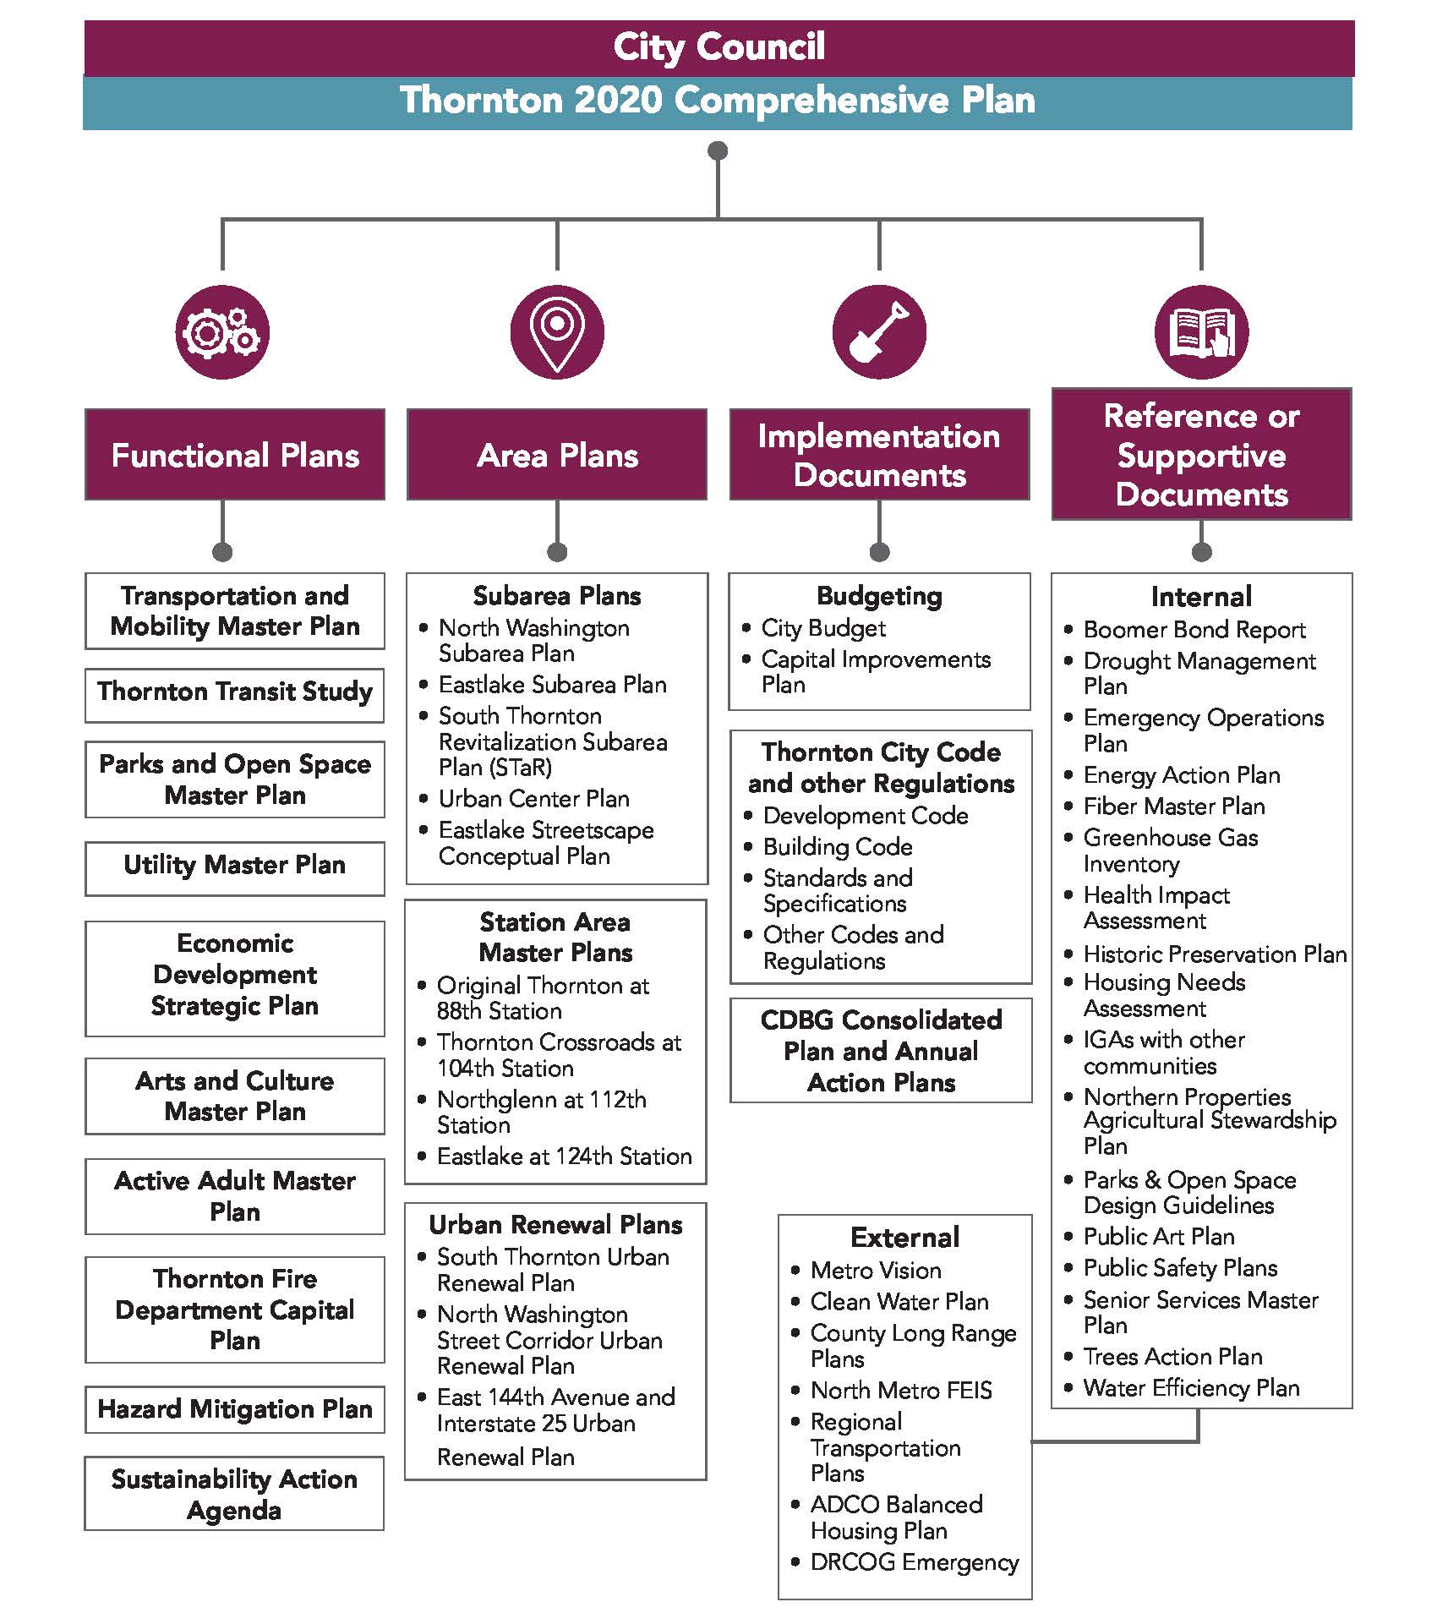
Comprehensive Plan –
“The Umbrella Plan”
  The Comprehensive Plan provides guidance for all other city plans and policies – providing an “umbrella” for which all other and more specific plans are under
  These more specific plans provide more specific policy guidance on topics such as:
      Land use management
      Area planning
      Transportation planning
      Infrastructure development
      Housing
      Economic development
Notes:
While the Comprehensive Plan provides the ‘big picture’ vision for Thornton, the city uses these more detailed plans to supplement and advance the community vision established in the Policy Framework.
Comp. Plan is comprised of other more specific plans and defers to specific plans for implementation. The types of plans that further refine and specify the comp. plan include: functional plans, area plans, implementation documents, and reference or supportive documents
For the future N Line stations, there are no more specific plans than the broad guidance provided in the Comp. Plan.
The primary scope of Long Range Planning involves the development of the City’s Comprehensive Plan and other guidance documents that set a vision for the community's future.
These documents consider a broad range of topics and how they inter-relate including land use, transportation and infrastructure, and economic development in order to create a cohesive long-term vision for the city.
And importantly, these planning processes typically involve extensive community engagement to ensure that plans reflect the overall values and aspirations of our residents and businesses.

Slide 11
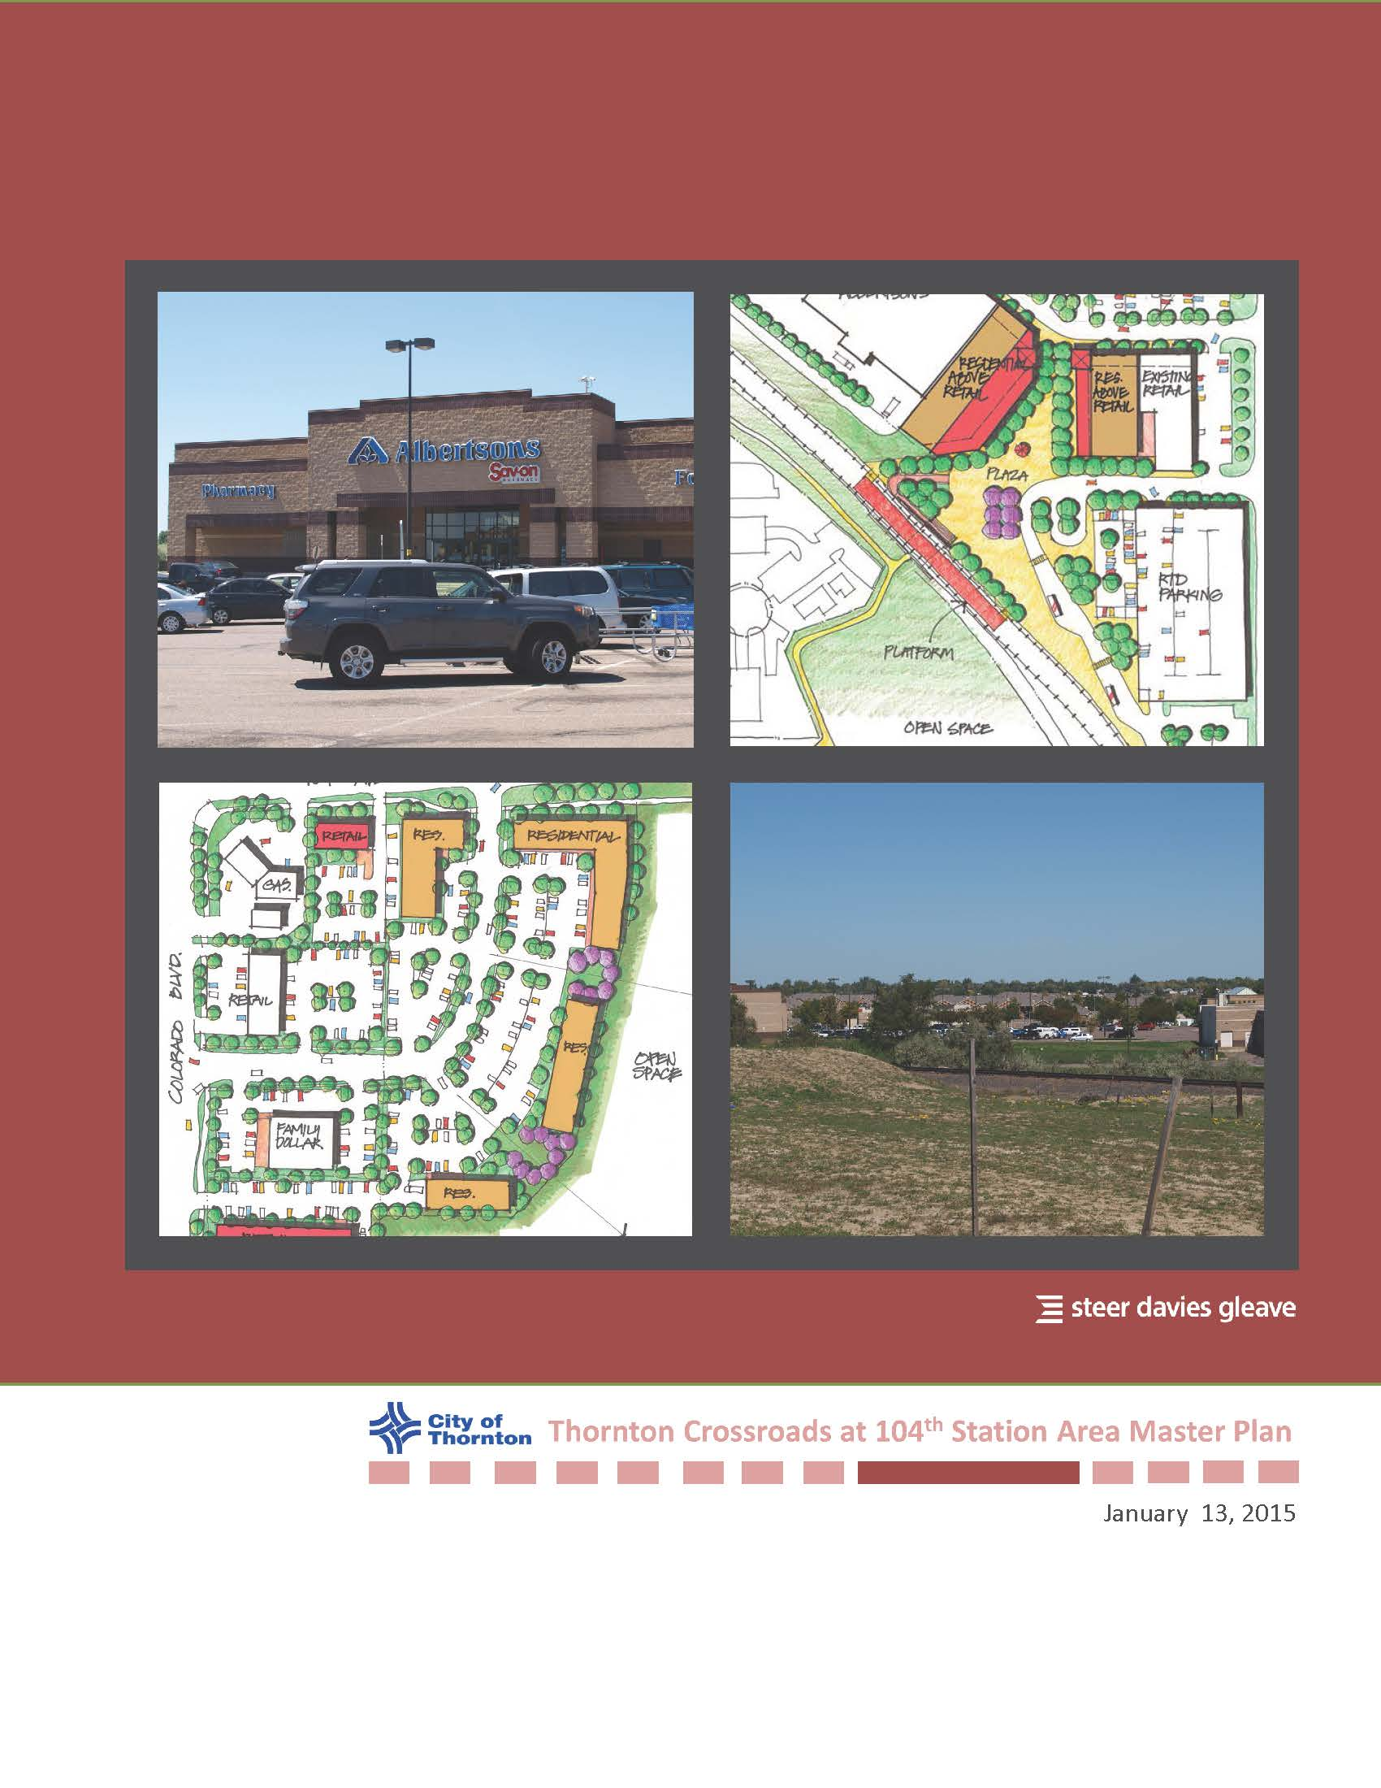
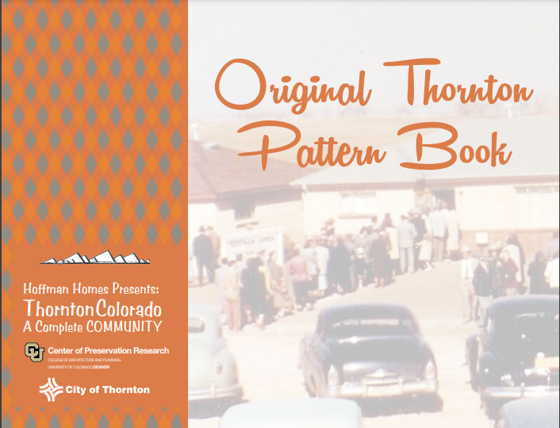
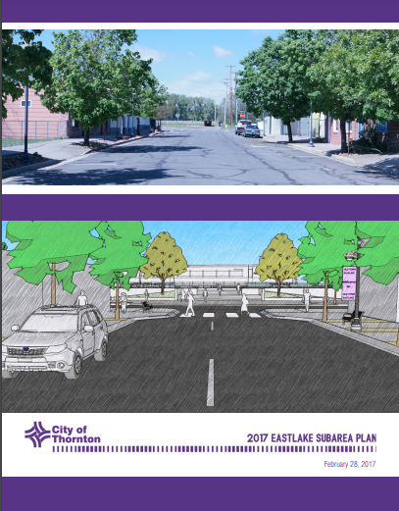
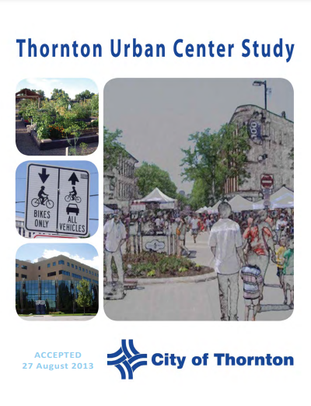
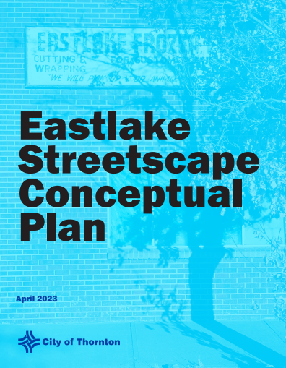
Area Plans
Long Range Planning
Plans that provide development recommendations for specific geographic areas, including:
  Eastlake Subarea Plan
  Station Area Master Plans
  North Washington Subarea Plan
  Thornton Urban Center Plan
  Original Thornton Pattern Book
  Urban Renewal Plans
Notes:
PC Recommendations to Council
Annexations
Zoning Amendments
Conceptual Site Plans
Classification of new uses
Development Code Amendments
Comprehensive Plan Amendments
Long range plans
STAMPs are compnont plans of the comp. plan. PC recommends

Slide 12
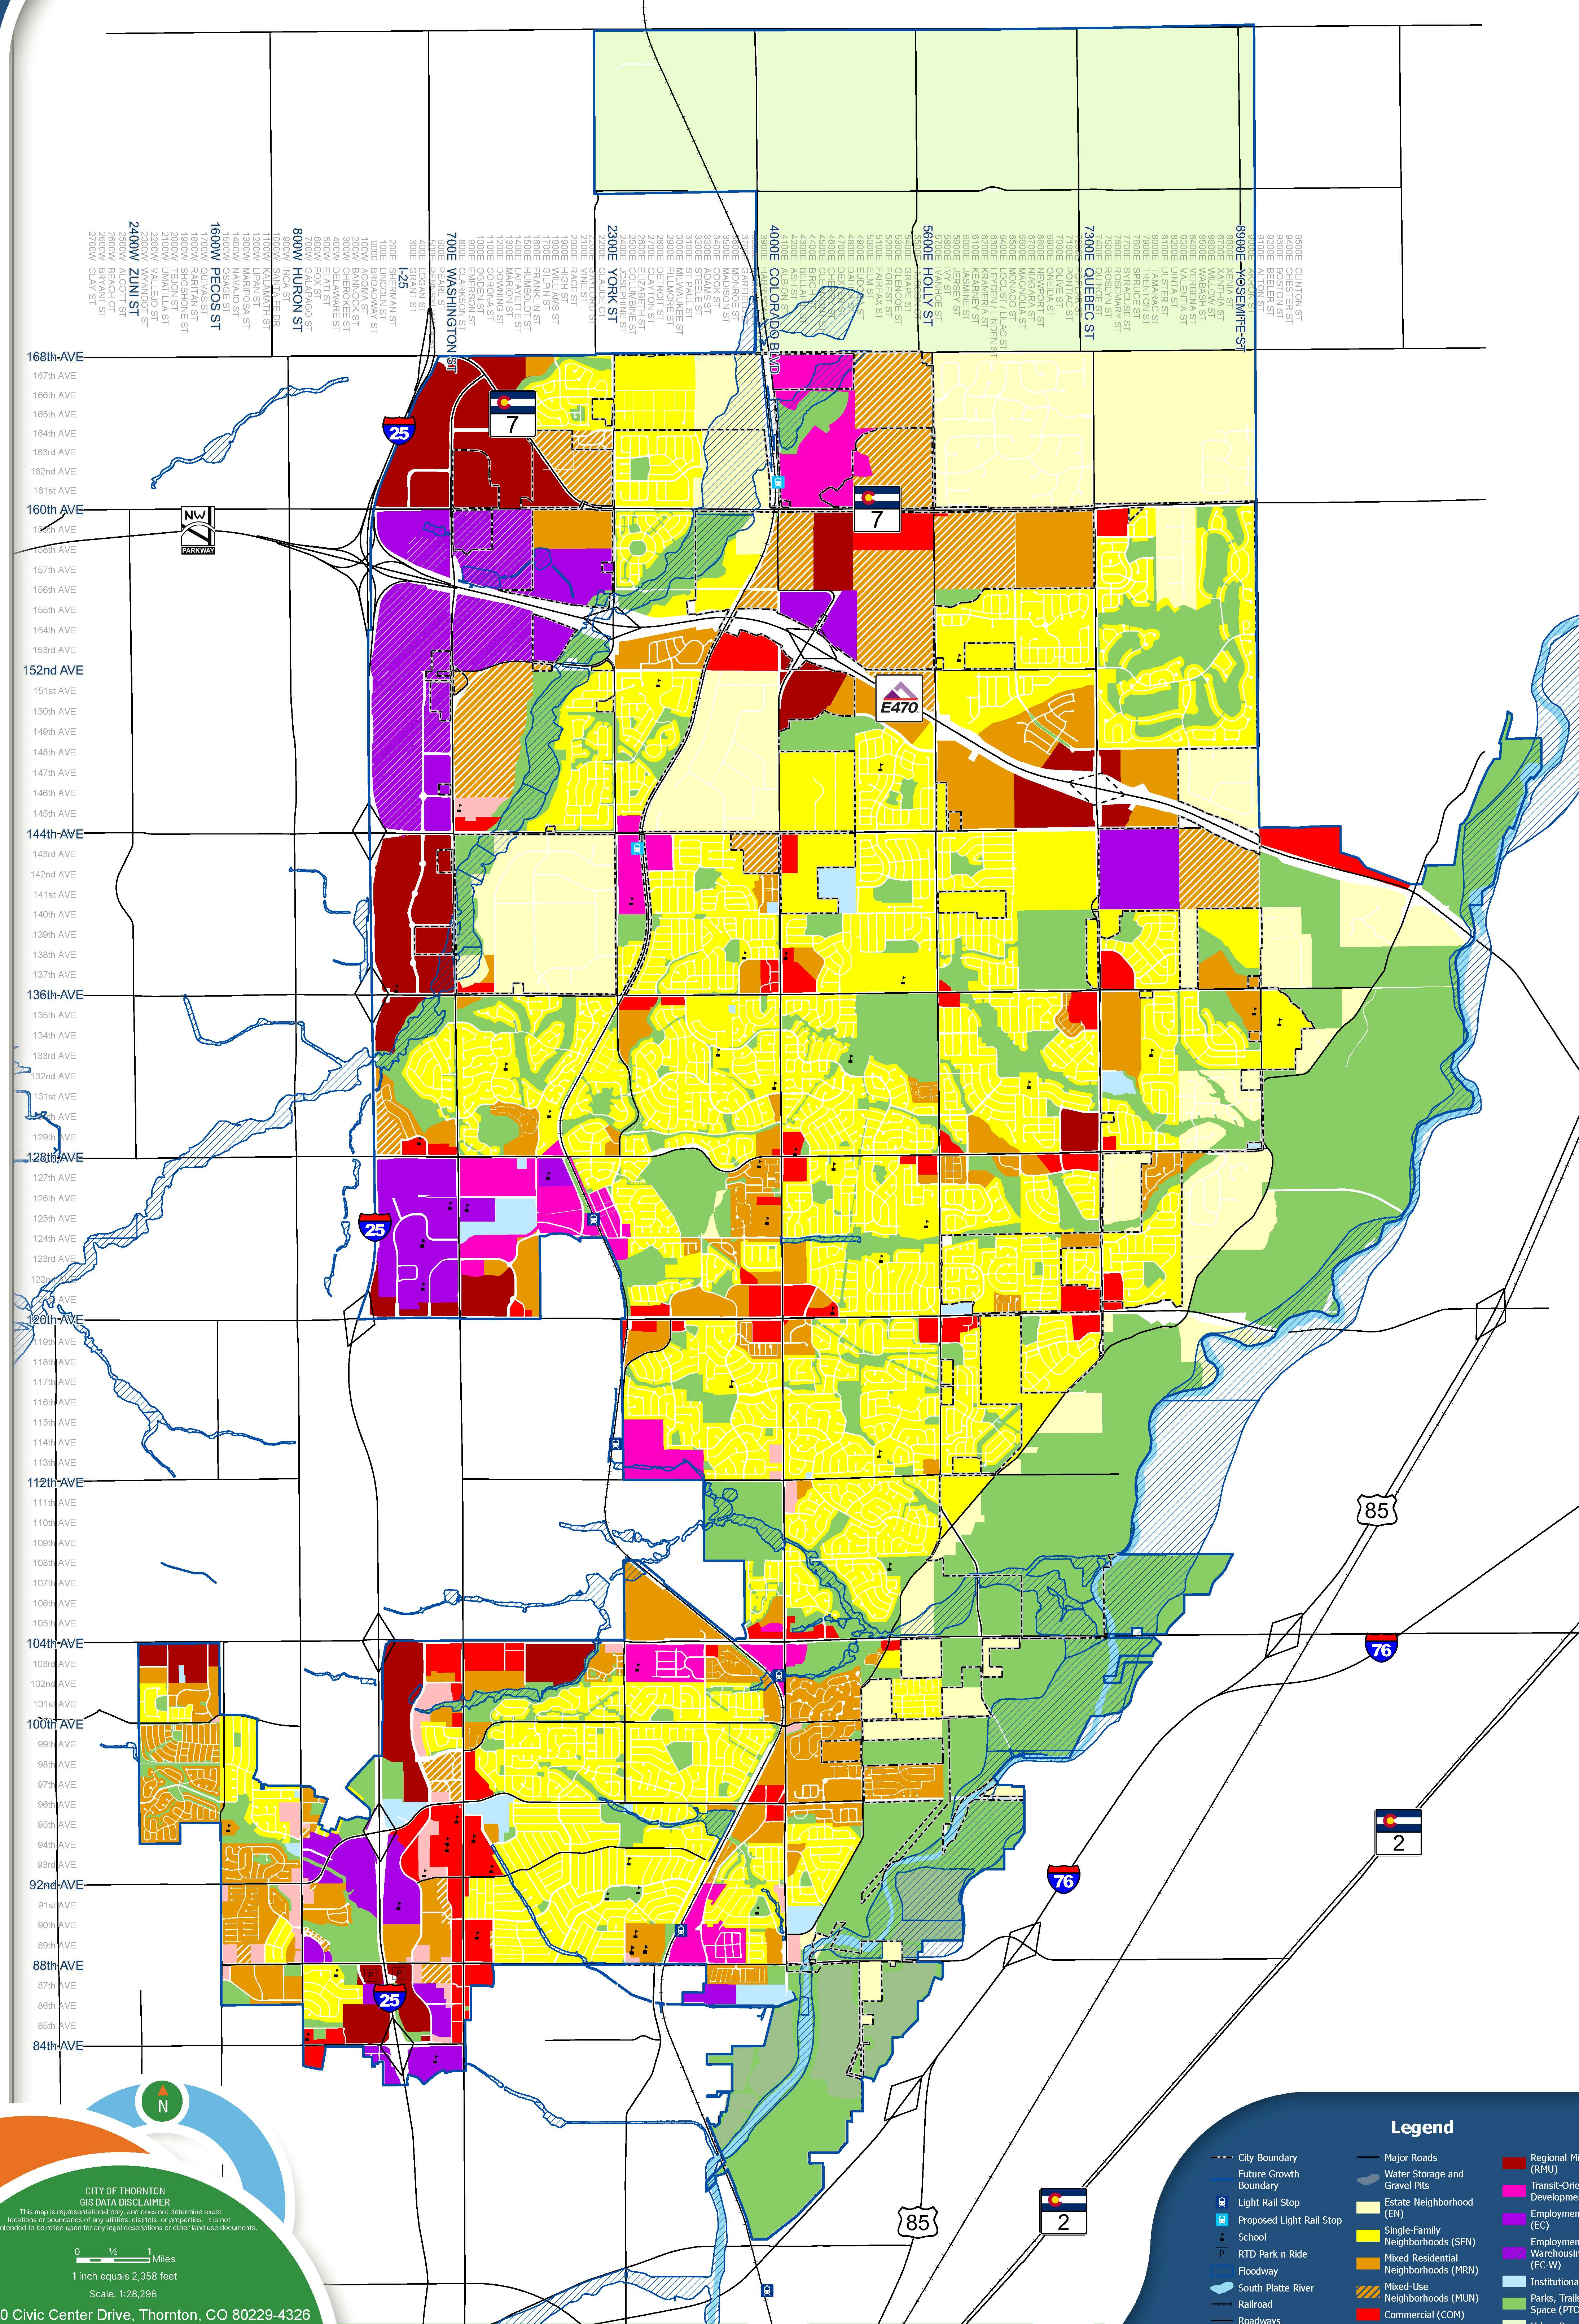
Comprehensive Plan & Zoning Alignment
The FLUM and associated Future Land Use Categories are a material component of the Comprehensive Plan
Comprehensive Plan assigns ‘Future Land Use’ designations to properties
  Broad land use characteristics
  Guides type of development appropriate and desired over the long-term – especially important for vacant parcels and redevelopment
Development Code establishes and assigns ‘Zoning Districts’ to properties
Some zones specifying Comprehensive Plan conformance
  E.g. TOD District requires a mix of uses or STAMP conformance
  Development Code provides guidance for which Zoning Districts align with each Future Land Use designation
Notes:
The FLUM serves as a tool to guide future development within the city and its Future Growth Area by conveying a vision for different types of places and land uses within Thornton as well as unincorporated land in Adams and Weld Counties
Comprehensive Plan assigns ‘Future Land Use’ designations to properties
Broad land use characteristics
Guides type of development appropriate and desired over the long-term – especially important for vacant parcels and redevelopment
Does not change existing development, future oriented
More specific plans, like STAMPs, can further refine guidance
Development Code establishes and assigns ‘Zoning Districts’ to properties
Indicates which specific land uses are permitted and how they can be built, some zones specifying Comprehensive Plan conformance
E.g. TOD District requires a mix of uses or STAMP conformance
Section 18-3 of the Development Code provides guidance for which Zoning Districts align with each Future Land Use designation
Important when considering request to change the Comprehensive Plan’s FLUM designations and zoning district changes

Slide 13
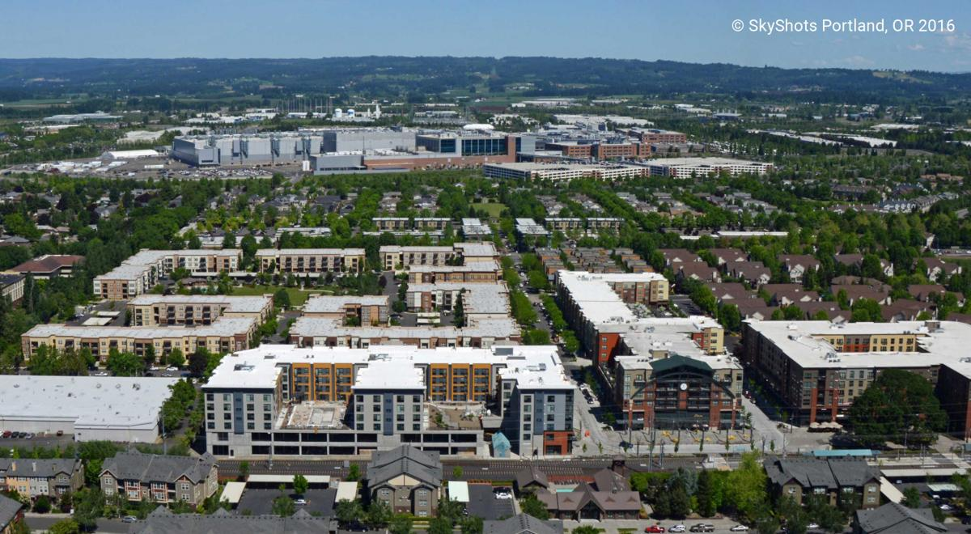
Case Studies
An aerial image of Orenco Station, a transit-oriented neighborhood served by the MAX light rail that serves the Portland Metro.

Slide 14
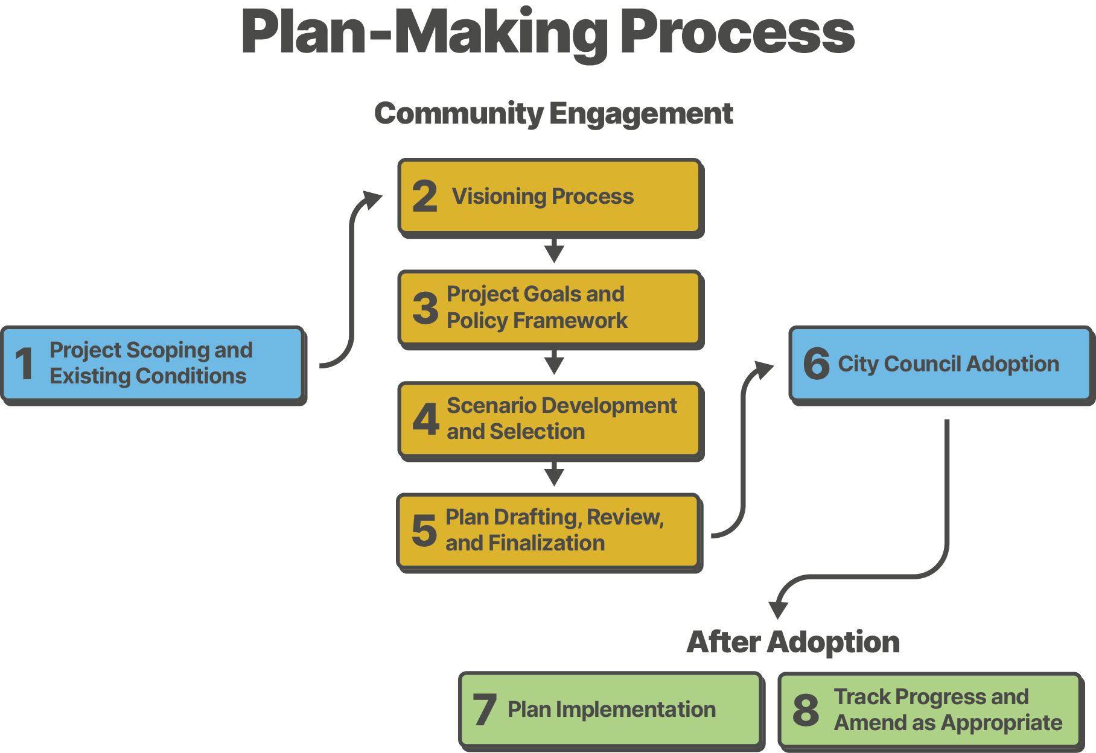
Planning Process – How a Plan is Made
Notes:
Defining the Planning Process

Slide 15
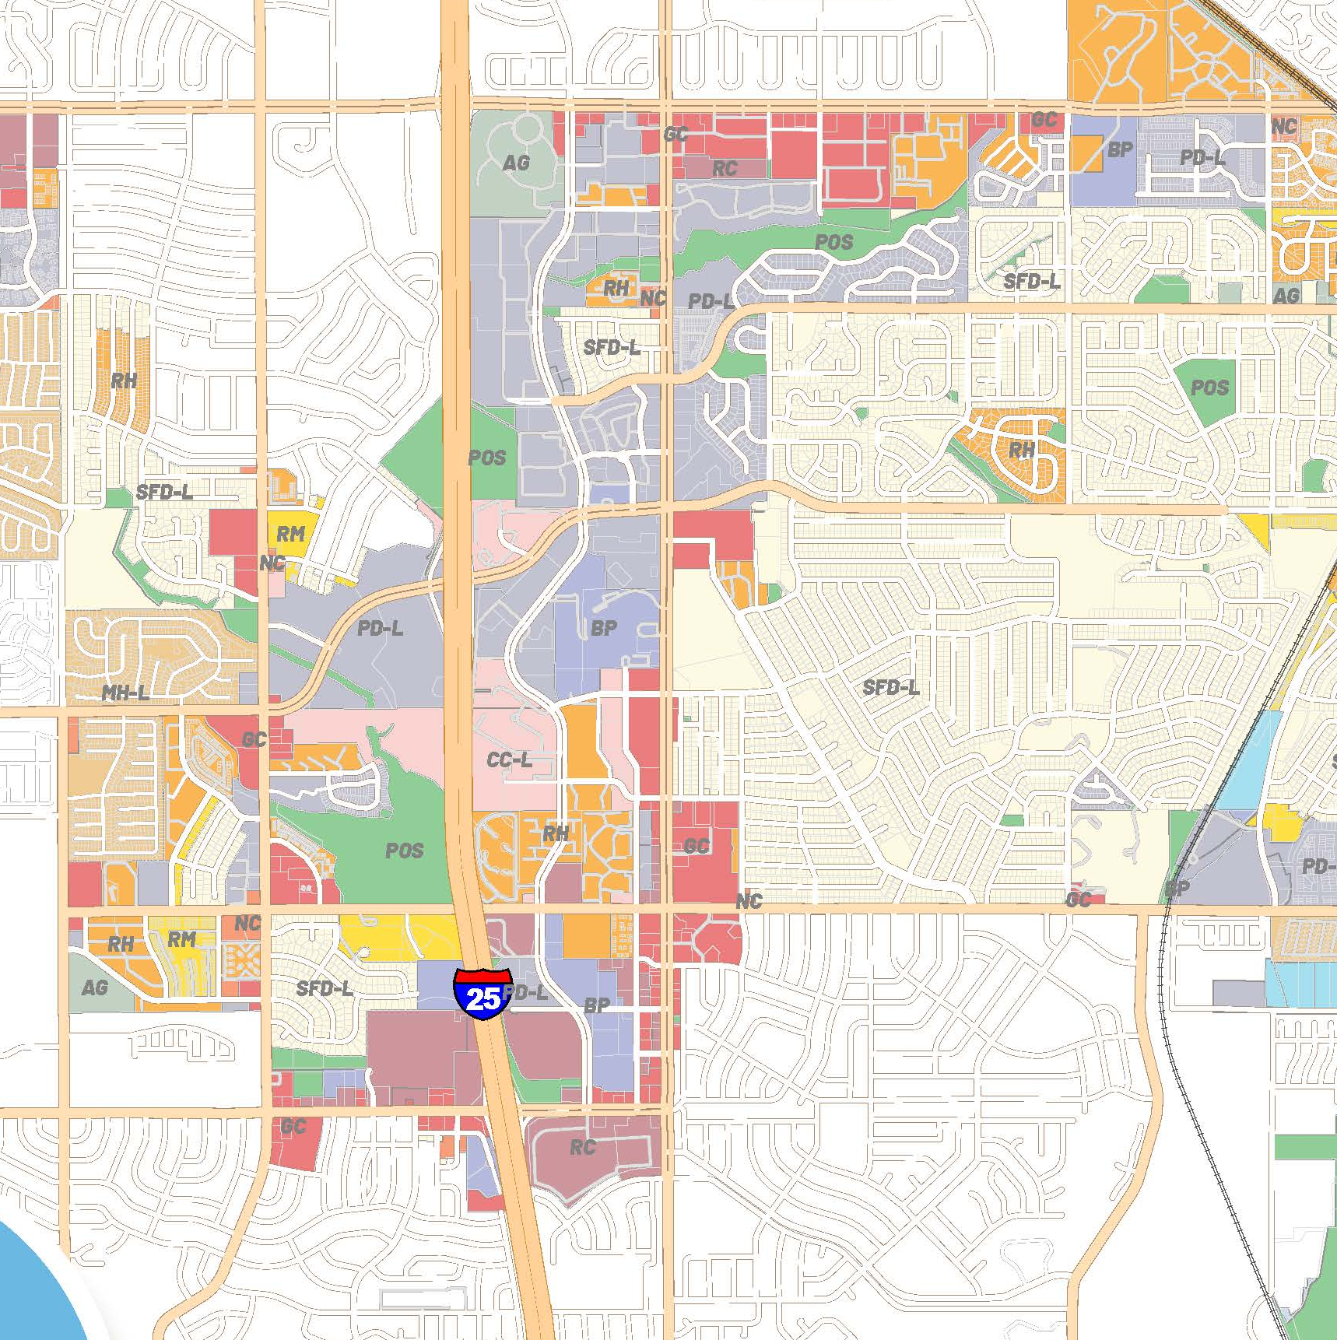
Zoning and Plan Implementation
A common thread of these case studies is that city-led rezoning implemented the plans
Development is required to comply with zoning district standards
In Thornton, properties designated as TOD on the FLUM that are not zoned TOD are not required to conform to the TOD zone standards
Therefore, to ensure implementation of the STAMPs rezoning should be explored
Notes:
indicate that development only has to comply with the zoning of the property and if the property is not zoned TOD, they can develop per the existing zoning.
A STAMP would create extra parameters and if city-initiated rezoning to TOD, would align with the city’s vision for these areas
- know what the existing zoning of the parcels are and explain what types of uses would be allowed to be built if we didn’t specific TOD
Also, a market study will be a critical component of the STAMPs to ensure that land uses align with market realities, although we also look into the future, not just immediate market

Slide 16
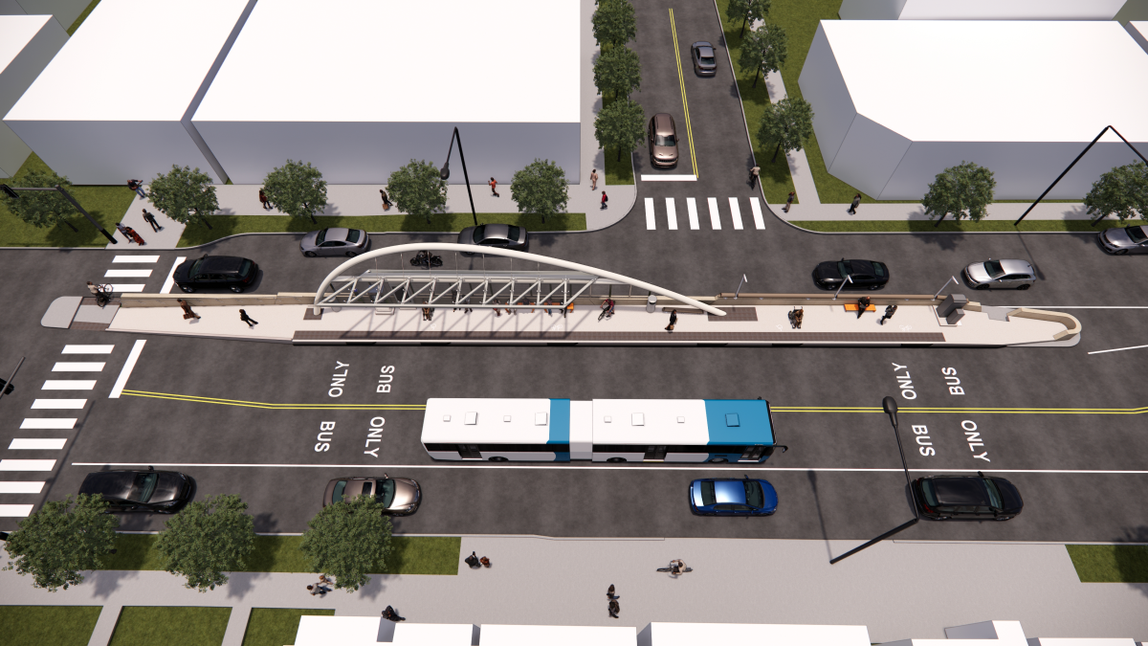
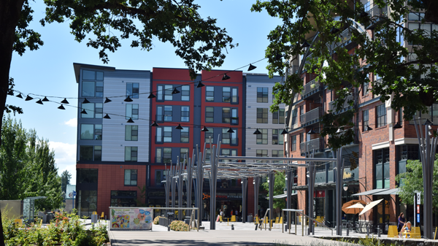
Denver, CO – Colfax DO-8 “Main-Street” Rezone
City-led rezoning of land near or abutting future bus rapid transit (BRT) stations on East Colfax.
Case Studies
The planning process is used across the US in a variety of contexts to implement local, regional, and state level planning efforts.
Four examples of the planning process in action:
Hillsboro, OR – Orenco Station Area Planning
Developer initiated development with city coordination of zoning via a multi-year rezoning effort for a light rail station and TOD neighborhood

Slide 17
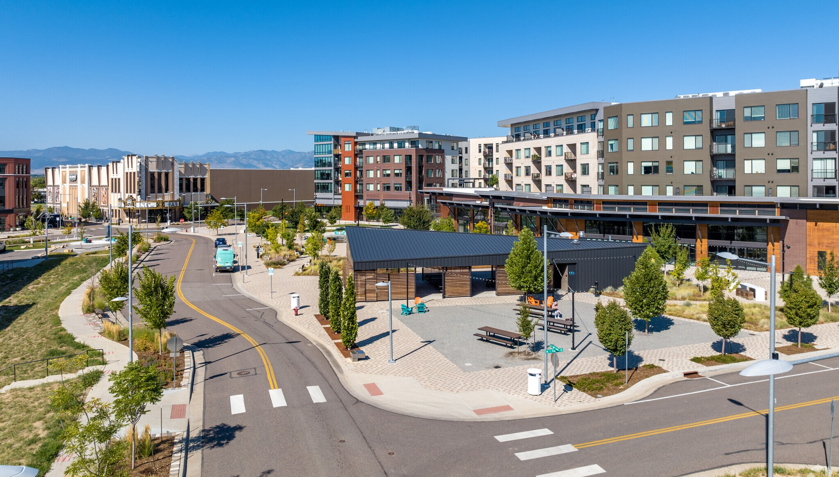
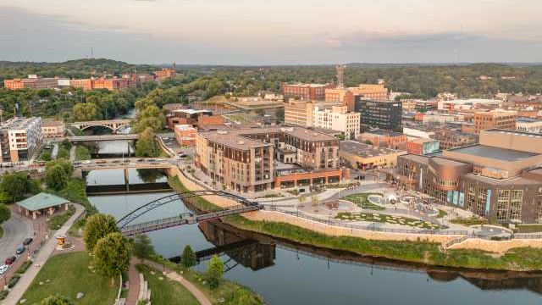
Westminster, CO – Downtown Specific Area Plan
City-led effort to create a new, downtown area for the city in a former site of a declining regional shopping mall.
Case Studies
The planning process is used across the US in a variety of contexts to implement local, regional, and state level planning efforts.
Four examples of the planning process in action:
Eau Clarie, WI – Citywide “Century Code Update”
City-led effort to modernize the city’s development code that also incorporated site specific rezoning efforts to promote more housing and urban development.

Slide 18



Community Kick-Off Meeting
Next Steps
Staff will conduct an initial community meeting to introduce station planning to the community
Plan-making Process Begins
Once funding and Council direction is secured, planning process for STAMPs will begin.
Scope of work for the STAMPs is being finalized. Next step would be to engage a consultant.
At a high-level, the next steps are displayed to the right.
City Council and Planning Commission
The STAMP planning process will engage the Planning Commission at distinct phases to provide recommendations and guidance on plan creation
Public Hearings
The final stage of the STAMPs planning process will include a public hearing to consider the plans’ adoption
Notes:
Hiring consultant
Project Initiation
Existing Conditions/Data Analysis
Market Study
Visioning
Alternatives Generation
Preferred Alternative Selection
Plan Finalization and Adoption Plan Implementation

Slide 19
Council’s Alternatives
Provide direction to proceed with the Station Area Master Plans for the Station Areas at 144th at York and Highway 7 at Colorado and explore the possibility of city-initiated rezoning to implement the STAMPs.
Provide direction to proceed with the Station Area Master Plans for the Station Areas at 144th at York and Highway 7 at Colorado but do not actively explore city-initiated rezoning to implement the STAMPs.
Provide direction to not proceed.
Staff recommends Alternative 1

Slide 20
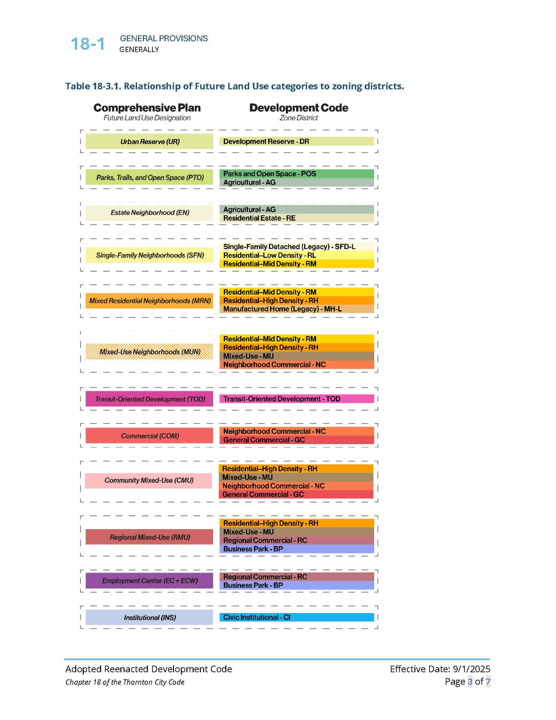
FLUM, Development Code, and Zoning

Slide 21
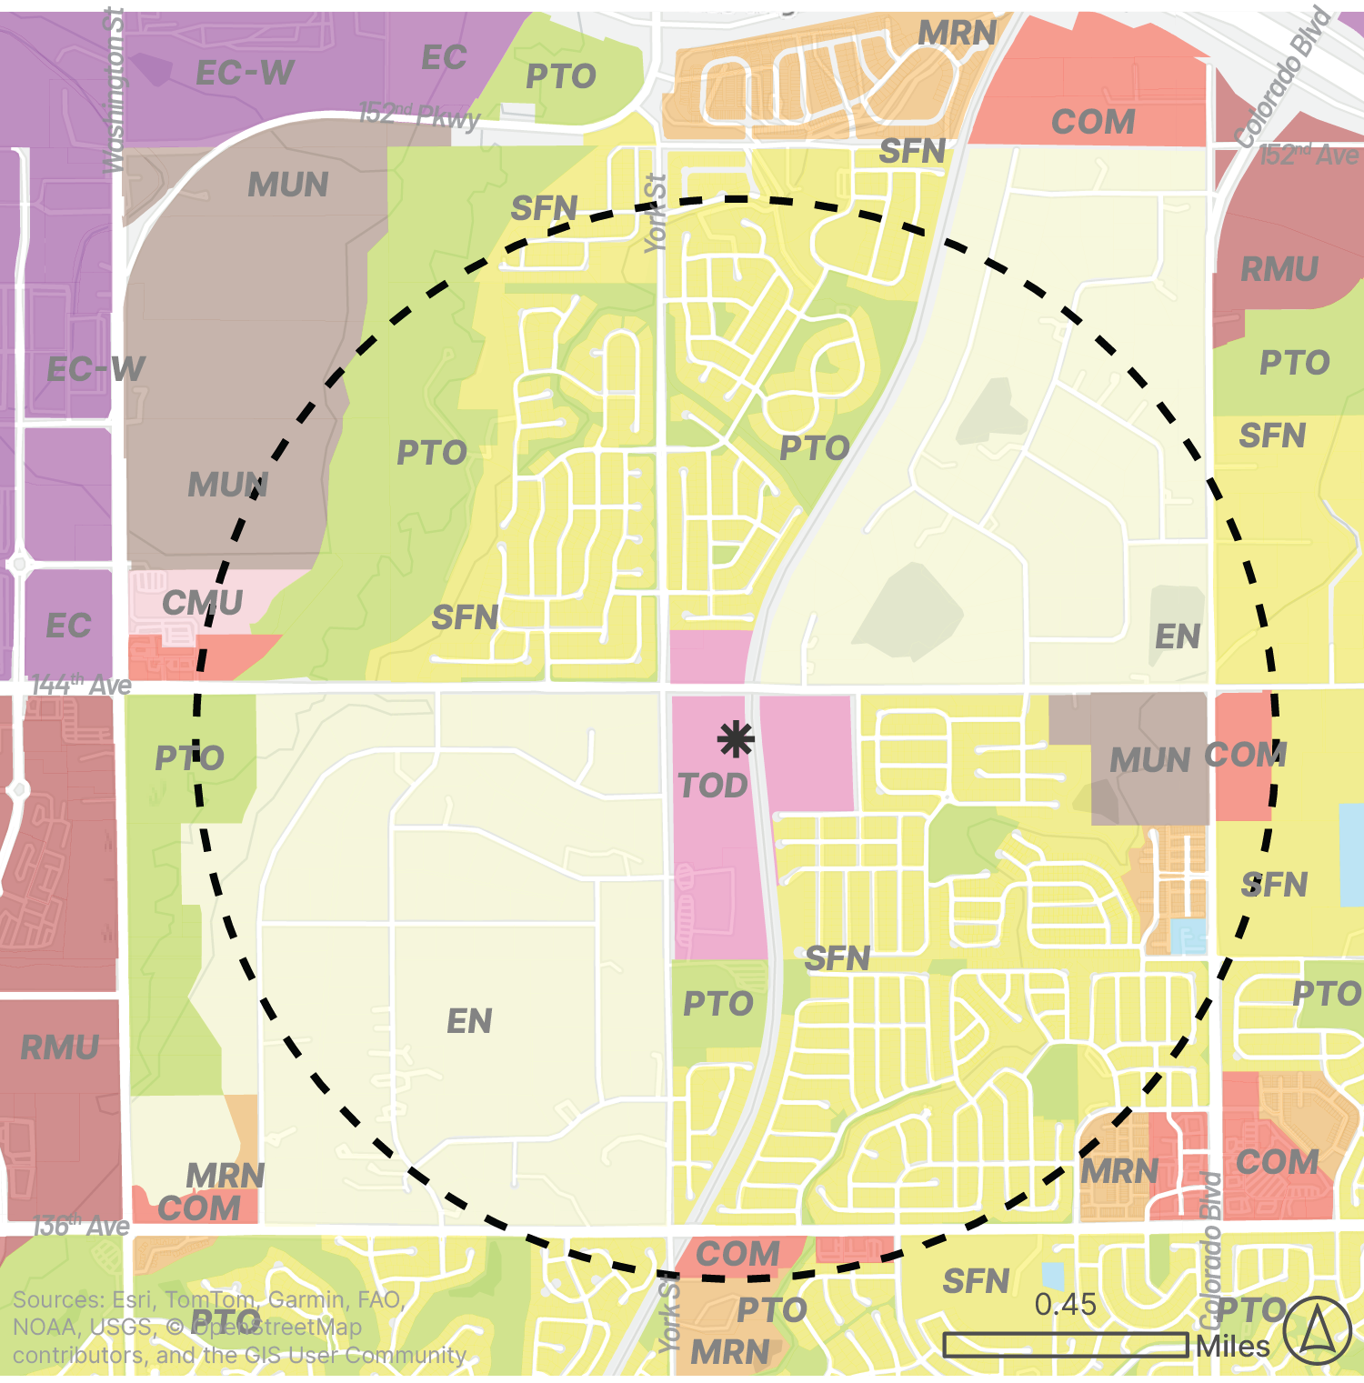
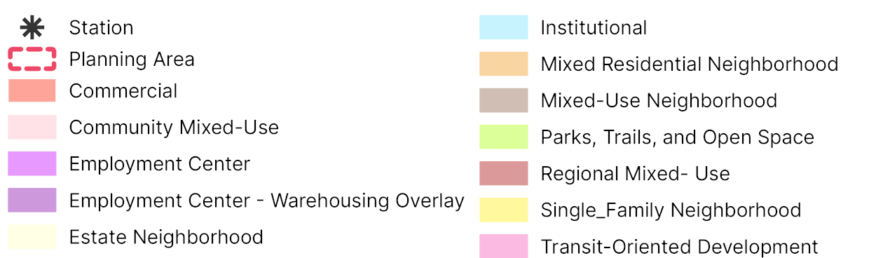
144th Avenue at York Street Station Area
Map displaying the Future Land Use Map (FLUM) designations in the station planning area

Slide 22
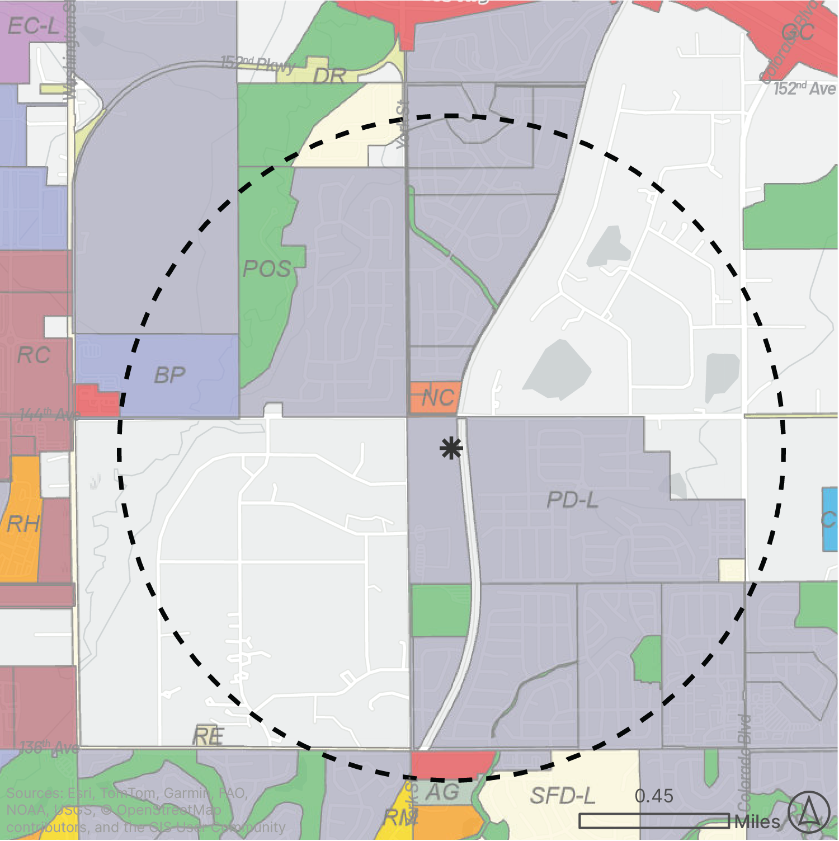
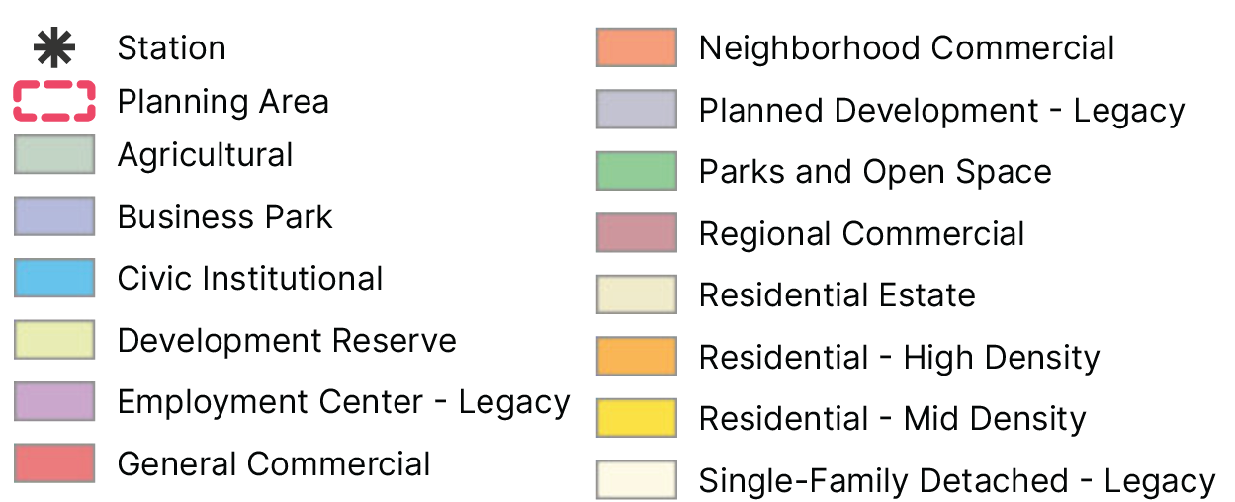
144th Avenue at York Street Station Area
Map displaying the zoning districts in the station planning area

Slide 23
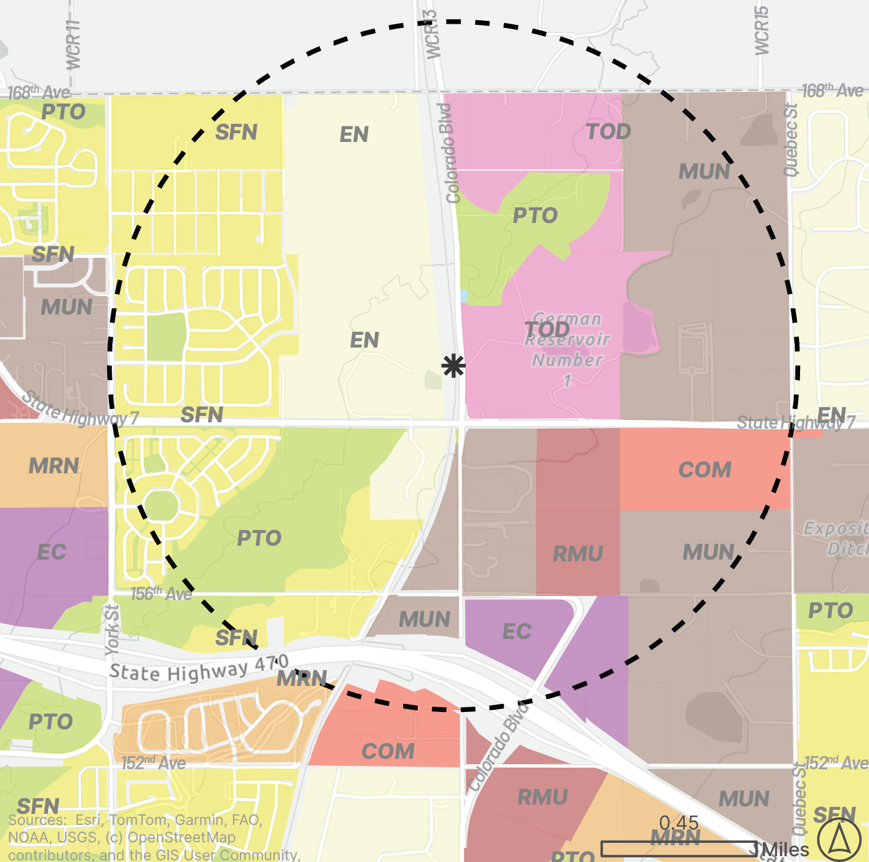
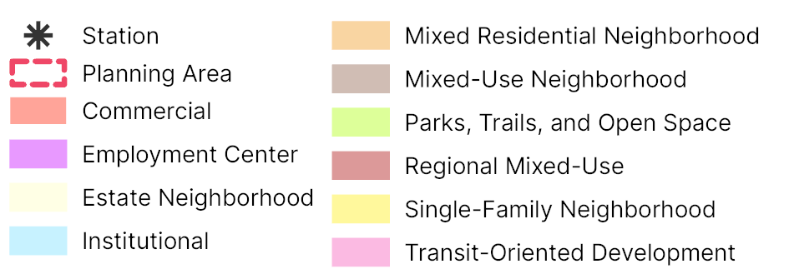
Highway 7 at Colorado Blvd. Station Area
Map displaying the Future Land Use Map (FLUM) designations in the station planning area

Slide 24
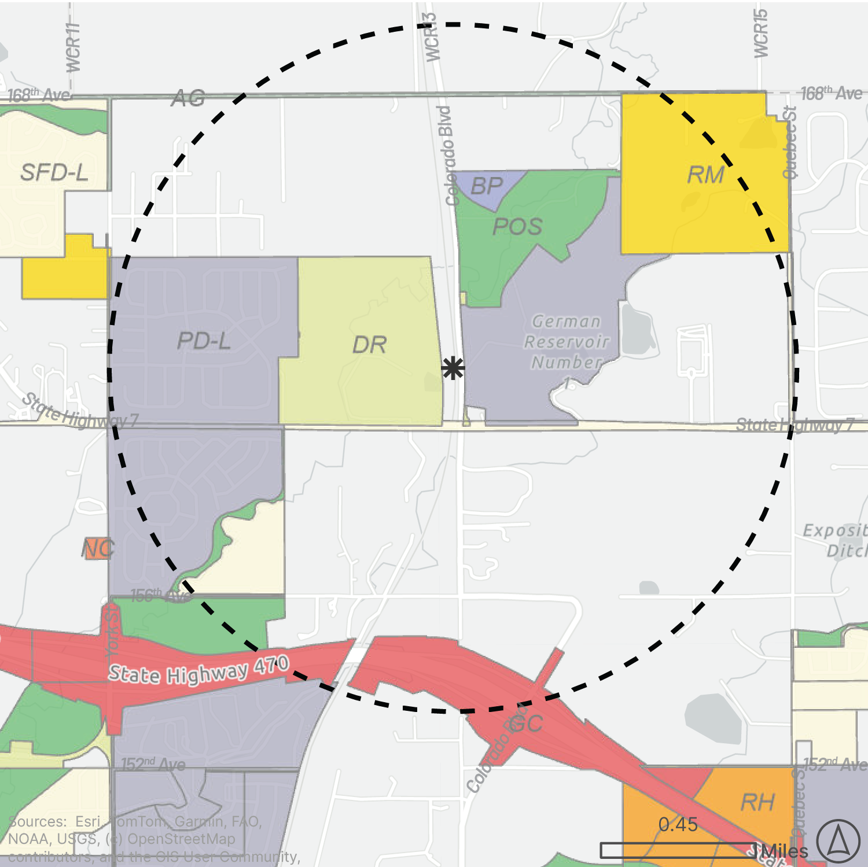
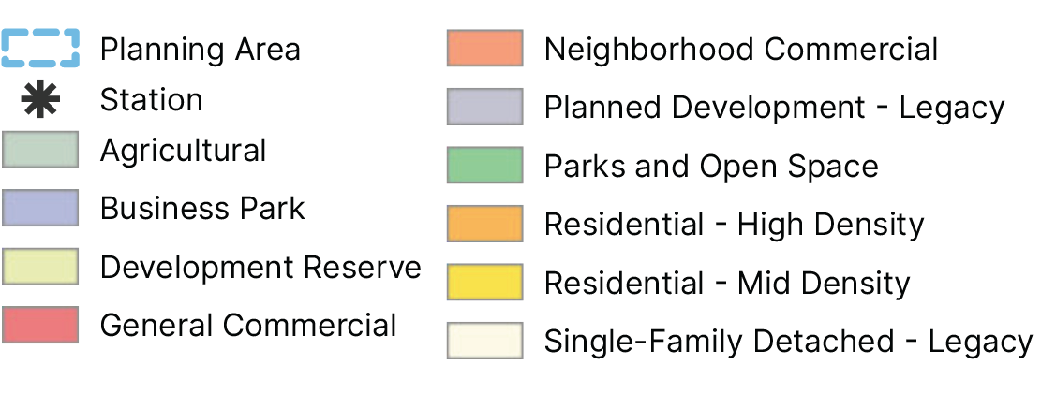
Highway 7 at Colorado Blvd. Station Area
Map displaying the zoning districts in the station planning area

